Slide 1
Types of Entrepreneurship
Techno- entrepreneurship
Women entrepreneurship
Social entrepreneurship
Intrapreneurship
Rural entrepreneurship
Family entrepreneurship

Slide 2
Techno-entrepreneurship
In today’s technology-driven world, a technopreneur usually starts a business with just an idea. First, they look at how things are done right now and think about the problems in those methods. Then they come up with better ideas to do things differently using technology.
A technopreneur uses technology to create a product or solution that makes work easier, faster, or smarter. Instead of following old or traditional ways, they improve them by using modern tools and innovation. Their goal is not just to change the present way of doing things, but also to shape how those things will be done in the future.

Slide 3
We all know Facebook, twitter and google some of the great examples of tech entrepreneurship.
Companies like these have created new industries all on their own, creating billions of dollars of value, boosting economies in the countries from which they grow.
Through it investment and jobs comes.
Through investment and jobs comes greater competitive advantage on an international scale, which in turn attracts more even investment which can be used to further develop the nation.
Countries like Israel, for example, have enjoyed great economic growth ,thanks to their tech talents.(What's app, global player in cyber security- check point company)

Slide 4
Impact of tech entrepreneur
The Impact so in addition to social media, thanks to tech entrepreneurs, we can now enjoy things like:-
Access to global markets and talent through things like Alibaba.
Work from wherever we are through things like smart phones and tablets.
The ability to connect around the globe with ease through things like Skype and Google Meet.

Slide 5
What is Tech Entrepreneurship?
It’s just like ‘normal’ entrepreneurship with a particular focus on opportunities that require, or become amplified by, technology.
So this means that tech entrepreneurs spot and identify opportunities in much the same way as others, and essentially go about developing solutions in much the same way too. The big difference is that they utilise and rely on their unique ‘tech’ skill sets to create their competitive advantage.

Slide 6
Elements of Successful Tech -Entrepreneurship
Need to create Unique Value
These days, many people strive to solve the same problem or offer the same value(product).
As a result, particularly in the tech field, creating truly unique value is of critical importance.
As soon as a customer sees something they’ve seen before, it’s probably not long your customer anymore!
Stay up-to-date
Technology changes very fast. What is useful today may become outdated tomorrow.
Entrepreneurs should keep learning about new technologies and changing customer needs
Doing something unique but outdated has no value in tech business.

Slide 7
Get the right people
Tech ventures need people who not only technical smarts but also a one who is creative ,keep learning and commit to grow companies. This is a hard balance to find (skills + long term commitment).
Size of the target market
Tech businesses are expensive to run (good staff, technology, innovation).
Once a tech product is made, selling it to more people brings much higher profit with almost the same cost.
So they must sell to a large number of customers, this could be thousands or even millions of people
Serving 1,000 customers or 1 million customers does not cost very differently in tech businesses

Slide 8
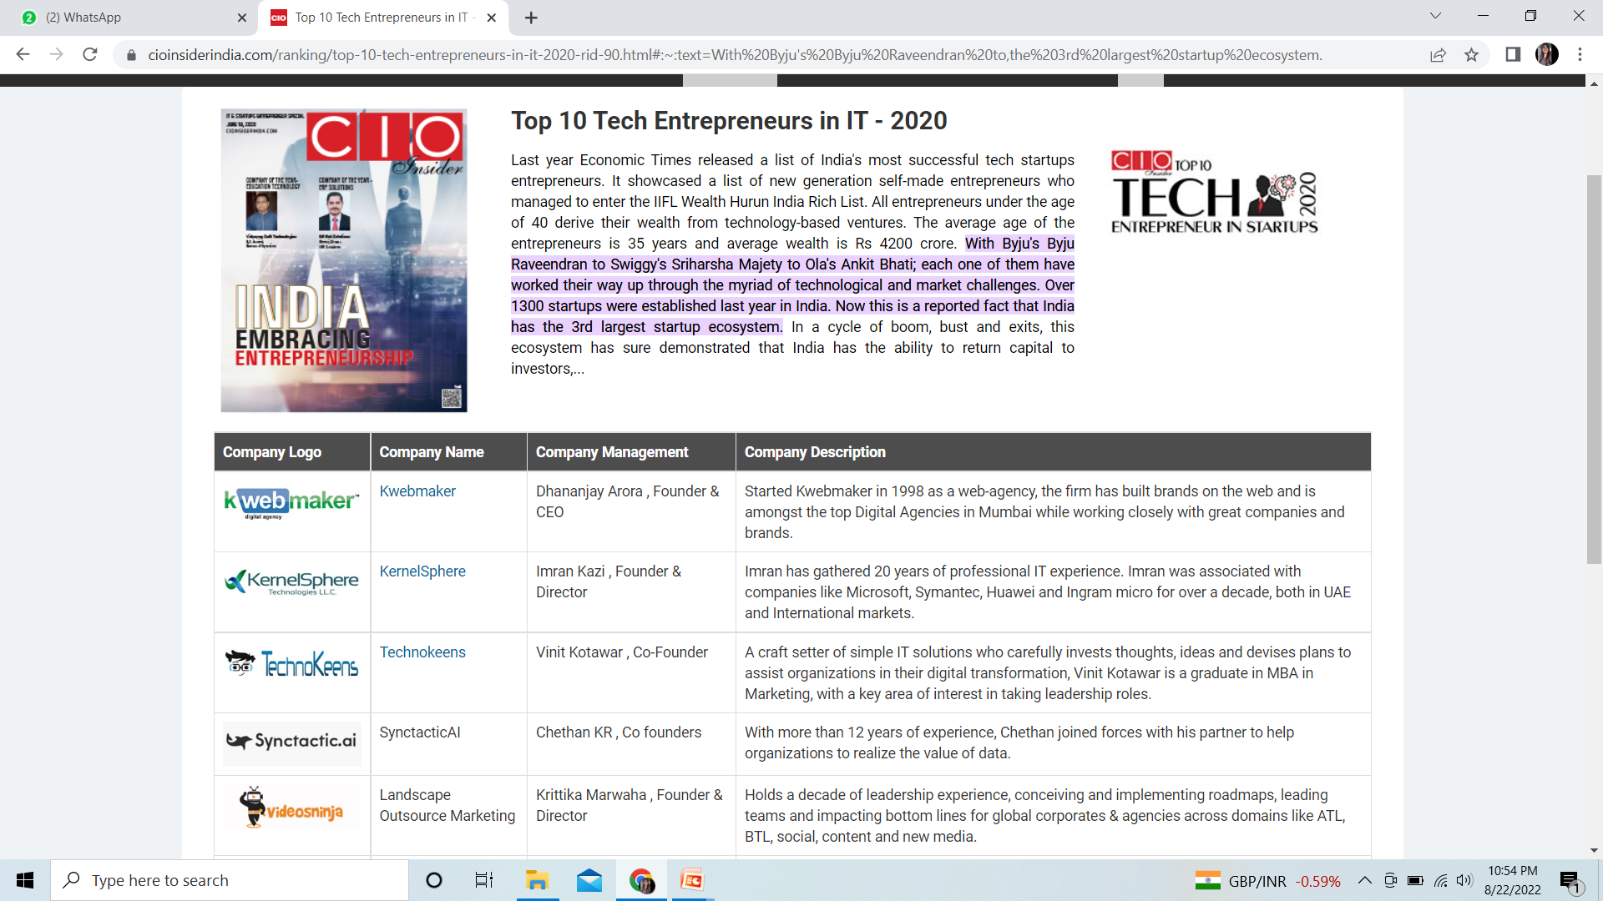

Slide 9
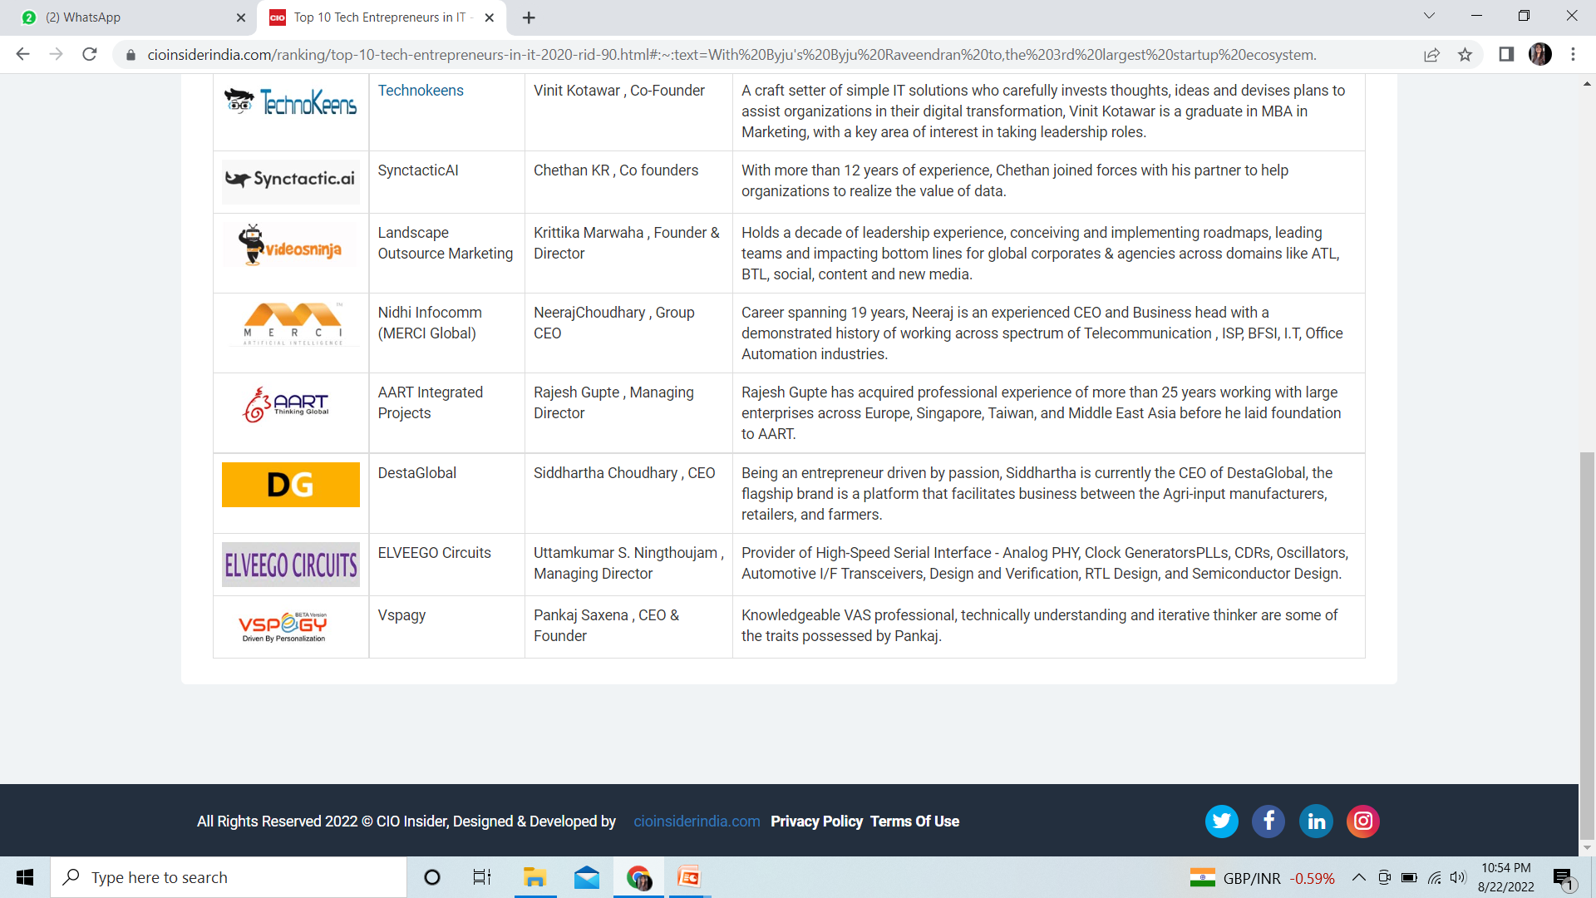

Slide 10
Women entrepreneurs
Women entrepreneurs may be defined as a woman or a group of women who initiate, organize and run a business concern.
Women entrepreneurs are those women who think of a business enterprise, initiate it, organize and combine factors of production, operate the enterprise and undertake risks and handle economic uncertainty involved in running it.
“ An enterprise owned and controlled by a women having a minimum financial interest of 51% of the capital & giving at least 51% of the employment generated in the enterprise to women”.

Slide 11
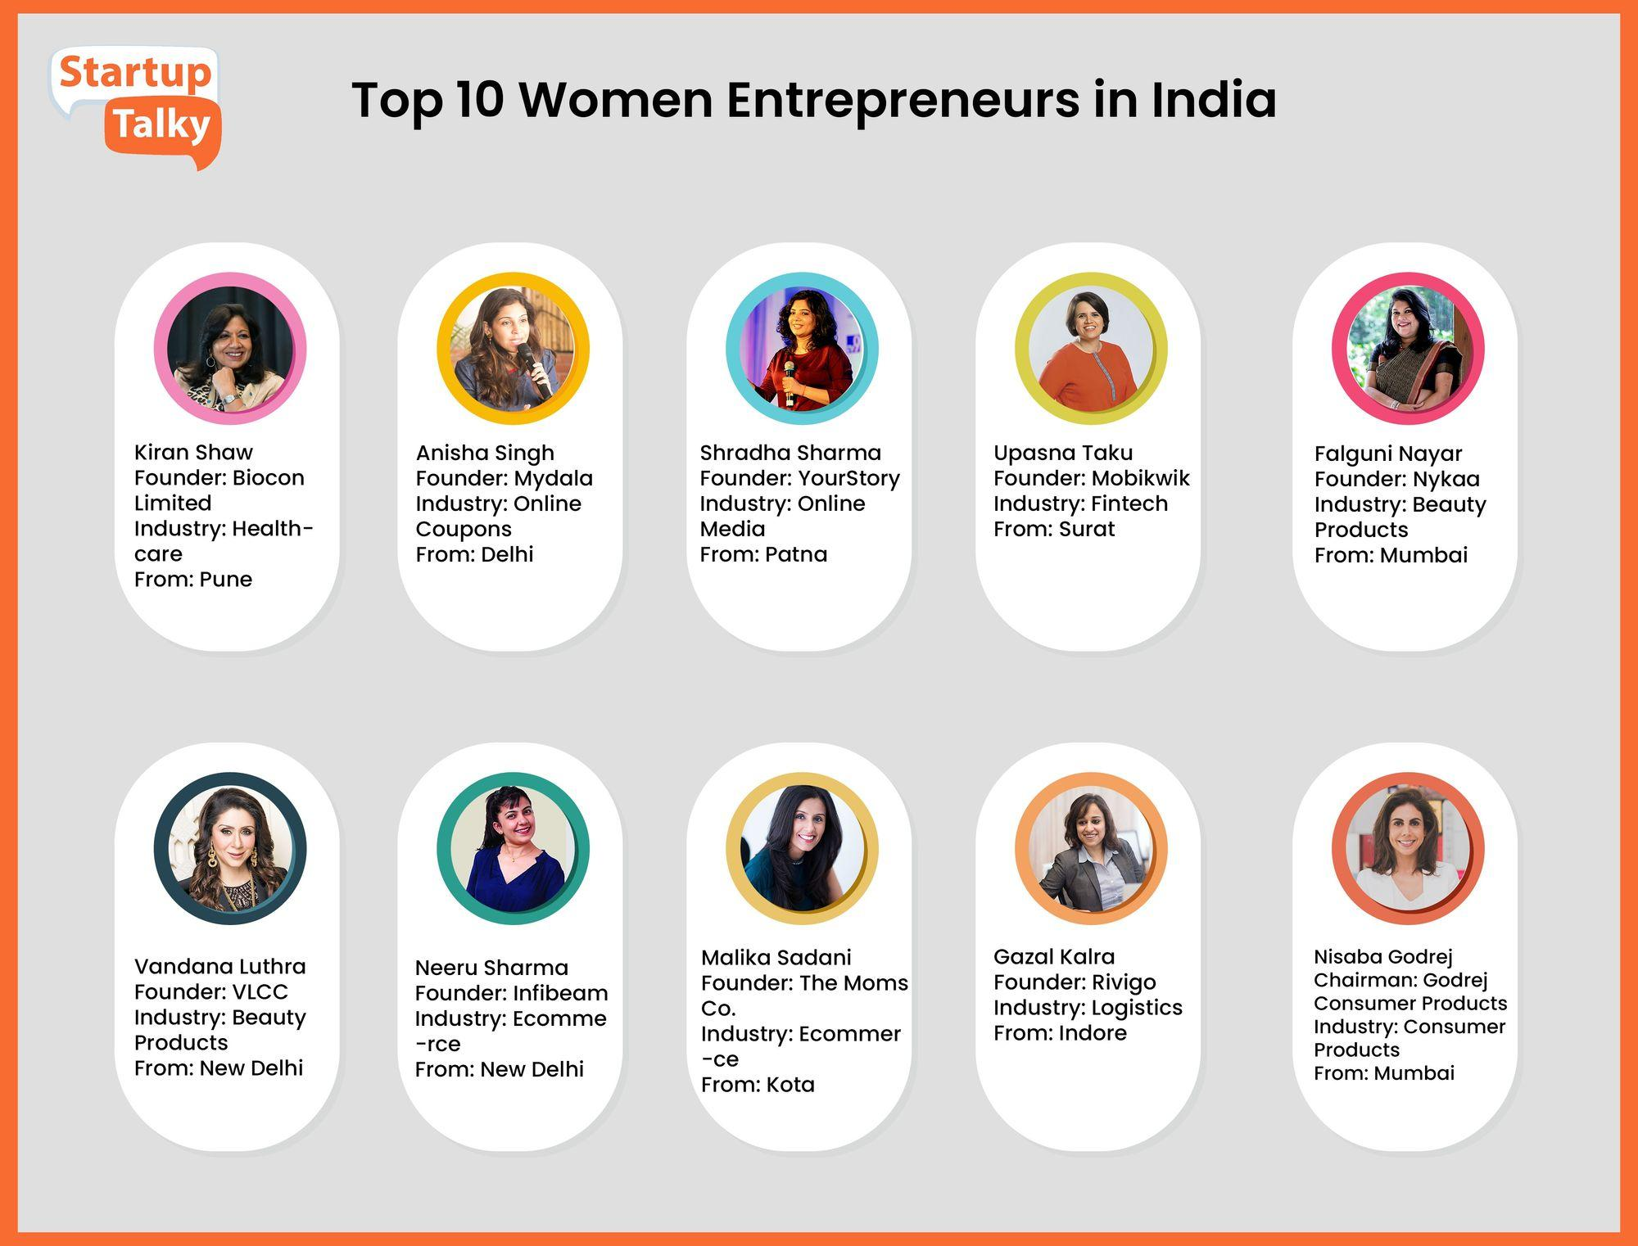

Slide 12
“Somebody once said, educate a woman & u will educate a family.” But the new saying is empower a woman to become an entrepreneur, & you will create an entire family of entrepreneurs. Women entrepreneurship is the need of the nation right now, it is the surest quickest way to make INDIA a super power”

Slide 13
Challenges faced by women entrepreneurs
Microsphere- Mainly confined to the local environment and obliged to live close to the family.
Mesosphere- Work at a regional or national level.
Acts as a barrier when providing assistance to them within this environment.
3. Macrosphere- working at global level

Slide 14
Why women becomes entrepreneur
To become economically independent
To establish their own enterprise
To establish their identity in society
To achieve Excellence
To build confidence to themselves
To develop risk assuming ability
To claim equal status in society
To secure greater freedom & mobility Liking for business
An urge to do something new

Slide 15
Strategies for the development of women entrepreneurs
Encouraging home-based business
Widespread business education(Workshops, conferences, training…)
Better financial assistance(venezuelas women development bank)
Wider access to technology(With the help of internet)

Slide 16
Problems faced by women entrepreneur
Male dominated society
Lack of business information
Low risk taking ability
Lack of education
Lack of family support

Slide 17
Government incentives
Mahila Vikas Nidhi
District industries center
Rashtriya Mahila Kosh

Slide 18
Mahila vikas nidhi
Under Mahila Vikas Nidhi, a cumulative help of Rs. 80.4 million was sanctioned, during the period 1990-2001 . Various training- cum production centres set up by NGOs mostly relate to activities like spinning, weaving, block printing, handloom products, handicrafts etc.
Mahila Udyam Nidhi (MUN) is a SIDBI-operated scheme providing soft loans up to ₹10 lakh without collateral to women entrepreneurs for setting up or upgrading small-scale industries. It features low-interest rates, and a 6-8 year repayment period, aiming to foster financial independence and self-employment.

Slide 19
District industries center(DICs)
DICs arrange various lectures and seminars etc. In girls colleges and technical institutes to encourage them to set up their own enterprises.
They facilitate business setup, licensing, finance, and training for entrepreneurs. Established in 1978, they act as a vital link between government policies and local industrial development.

Slide 20
Rashtriya Mahila Kosh
It was set up in 1993 to provide micro- credit to poor and rural women who had no access to financial institution at with very low transaction costs, rates of interest and simple procedures. It proved quite useful for lower income group women.
It provides loans through Intermediate Micro-financing Organizations (IMOs) like Self Help Groups (SHGs), NGOs, etc. instead of giving loans directly to women.

Slide 21
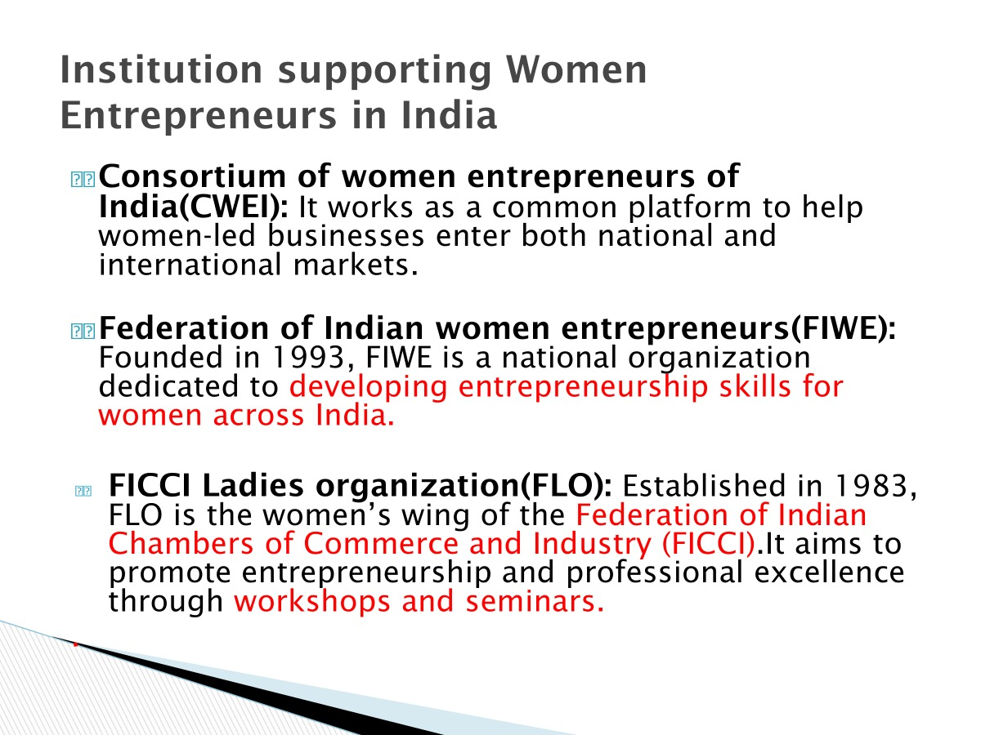

Slide 22
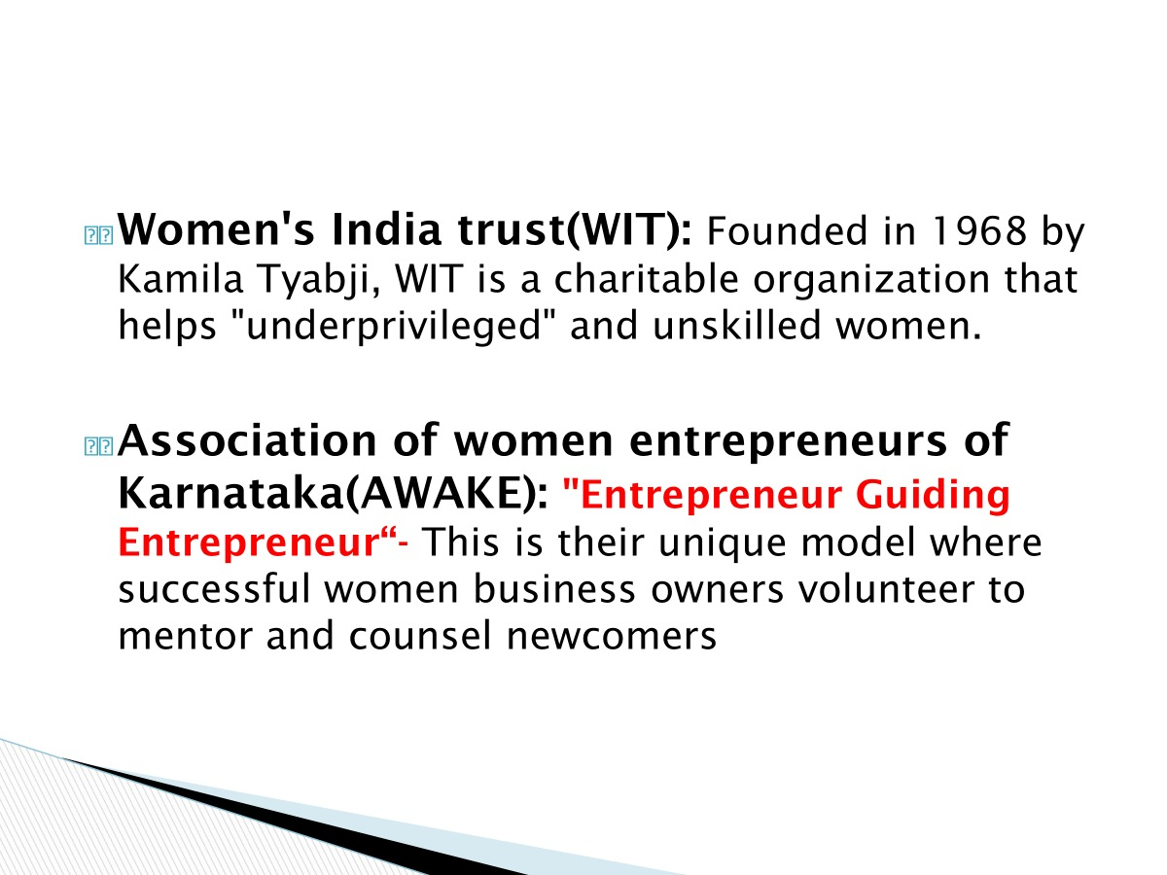

Slide 23
Social entrepreneurship
Social entrepreneurship is the process by which individuals, startups and entrepreneurs develop and fund solutions that directly address social issues. A social entrepreneur, therefore, is a person who explores business opportunities that have a positive impact on their community, in society or the world.

Slide 24
Social entrepreneurship is the process of recognizing and resourcefully pursuing opportunities to create social value. Social entrepreneurs are innovative , resourceful, and results oriented. They draw upon the best thinking in both the business and non-profit worlds to develop strategies that maximize their social impact.
These leaders operate in all kinds of organizations : large and small; new and old; religious and secular; non-profit, for-profit, and hybrid. These organizations comprise the ‘social sector’.

Slide 25
For-profit entrepreneurs typically measure performance using business metrics like profit, revenues and increases in stock price. Social entrepreneurs, however, are either non-profits, or they blend for-profit goals with generating a positive "return to society“
Typically attempts broad social, cultural and environmental goals often associated with the voluntary sector in areas such as over coming poverty , health care and community development.

Slide 26
Social entrepreneurship Drivers
Social issues inadequately addressed by government.
Need to raise funds for charities.
Changes in public sector.
Budget cuts require new revenue streams
Change rather than good stewardship (innovating rather than just maintaining old ways).
Growing demand for corporate social responsibility and ethical entrepreneurship

Slide 27
Social Entrepreneurship holds the key for future development in India. In the days to come, social entrepreneurs will play a crucial role in the advancement of social changes. The best thing about social entrepreneurship is that success is not mentioned by financial gains, but by the number of people these enterprises are able to reach and create a positive impact.
In the coming days, social entrepreneurship and Social businesses will be in the mainstream, which will hopefully impact the society positively.

Slide 28
Intrapreneurship
Intrapreneurship is Becoming an Entrepreneur on the Job.
Intrapreneur- A person within a large corporation who takes direct responsibility for turning an idea into a profitable finished product, process or service through assertive risk taking and innovation.
Intrapreneur have entrepreneurial skills blended with managerial skills but operate within an organization.

Slide 29
An intrapreneur is an employee who is tasked with developing an innovative idea or project within a company. The intrapreneur may not face the outsized risks or reap the outsized rewards of an entrepreneur. however, the intrapreneur has access to the resources and capabilities of an established company.
Intrapreneurs are “dreamers who do”, those who take hands-on responsibility for creating innovation of any kind within an organization.
Intrapreneur is an essential ingredient in every innovation.

Slide 30
3 Types of Intrapreneur
The Advocate
An Advocate is an employee inside a company who speaks for the customers.
The Advocate typically comes from a customer-facing role. They play a leading role in shaping the problem to be solved, defining the attributes of the customer and what the solution itself should look like. They are often easiest to spot in a company as they constantly come up with a stream of new ideas.
They often have roles like designer, business analyst, user experience or perhaps come from a sales or marketing background.

Slide 31
2. The Creator
The Creator is an internal facing role. The Creator is the person that will give life to your idea and create the prototype solution.
In the tech-centric world we live in, this person is often a programmer or engineer, but depending on your industry, they could have a very different job title. For example, if you work in the food industry then the Creator might be a chef or nutritionist.
Advocate says: “Customers want a faster app.”
Creator builds the app feature that makes it faster.

Slide 32
3. The Change Maker
The Change Maker is external business-facing person. This is the person that makes things happen… funding, partnerships, finance, sales. This person is usually an extrovert, self-confident and a great networker. The team will rely on The Change Maker to open doors for them, win-over the gatekeepers in the company and get the necessary buy-in from stakeholders.
Advocate finds a customer problem
Creator builds the solution
Change Maker gets approval, money, and support to launch it

Slide 33
Why should organizations embrace intrapreneurs?
Innovation-To create and bring into use profitable new products, processes, services, and ways of doing business.
Creation of new or alternative products
Opening of a new market
Capture of new sources of supply

Slide 34
Intraprenurial activity
Spotting ways to improve service
Save time, money, or make life easier
Visualizing variations of current products / services
Realizing new communication avenues with customers
Enhancing the quality
New ways to get the job done quicker or smarter

Slide 35
How does Business benefit?
Firms create competitive advantages by discovering new and better ways to compete in an industry and bringing them to market.
An enterprise that does not daily innovate will declines.
Even in a successful business the disease of bureaucracy and complacency is dangerous.

Slide 36
How do Intrapreneurs benefit?
Flexibility
Less restrictions and supportive environment
Recognition
Their ideas are vehicles towards advancement
Increased value to organization - increased PAYCHECK

Slide 37
Family business
Family firm is a corporation that is entirely owned by members of single family. It is also known as company owned, controlled and operated by members of one or several families.
Family business is one in which one or more members of one or more families have ownership, interest and significant commitment towards business.

Slide 38
Stages of development of a family business
1. Entrepreneurial (after identifying business opportunity)
This is the starting stage of the business. A family member finds a good business idea and starts the business.
The owner takes most of the decisions. Work is informal, and there are no proper systems yet.
Main focus is on survival and starting the business successfully.
Eg- Dhirubhai Ambani started Reliance in the 1960s as a small textile trading business.
2. Functionally specialized (growth phase)
The business starts growing. Different departments are created like marketing, finance, production, HR, etc.
Expansion and increasing sales is the goal.
Eg- As Reliance expanded into petrochemicals and refining. Separate departments were formed and Professional managers were hired.

Slide 39
3. Process-driven (system oriented)
The business becomes more organized and proper rules, systems, and procedures are made.
Decisions are not only taken by one person but whole management structure is formed. Work is done according to fixed processes.
Main focus is on efficiency and smooth operations.
Eg- When Reliance became a large corporate clear policies and systems were introduced, Corporate governance is improved. Now business runs smoothly even without the founder’s direct involvement.
4. Market-driven(matures)
The business becomes fully developed and stable and It focuses strongly on customer needs and market competition.
Strategic planning and professional management are used and the business may expand nationally or internationally.
Main focus is on sustainability and long-term success.

Slide 40
Characteristics
Importance of family relationship
Composition of the board of director
Loyalty
Dedication of family members
Male-dominated
Dominance of certain trading communities

Slide 41
Various types of family businesses
1. Family owned business-
This is a business that is owned by members of one family. The main goal is to earn profit.
Family members may not manage it daily, but they own it.
2. A family owned and managed business-
The business is not only owned by the family but also run by them.
At least one family member is actively involved in managing daily work.
3. A family owned and led business-
Here, the family owns the company and also makes important decisions may they are not involved in operational or day to day activity's decision making.
A family member is part of the Board of Directors (top decision-making group).

Slide 42
Family business model- Based on family and business orientation.
Model is based on how much importance is given to business performance (profit, growth, professionalism) and how much importance is given to family relationships and control.
Captain- low business and low family orientation
Family team- low business and relatively high family orientation
Professional family- low family orientation and high business orientation
Family enterprise model- high family orientation and high business orientation

Slide 43
Challenges faced by family-owned business
Non-participating family member
Family emotions
Family versus business
Defining authority
Fair to all approach(equal salary or profit and giving opportunities will be difficult led to conflict)
Retaining non-family professionals
Change management
Decision making
Succession planning

Slide 44
Rural entrepreneurship
Rural Entrepreneurship is that entrepreneurship which ensures value addition to rural resources in rural areas engaging largely rural human resources.
Rural entrepreneurship refers to the development of a new enterprise which pioneers new products and services, creates a new market for its offerings or uses advanced technology in the rural area.

Slide 45
Why rural entrepreneurship?
As people are migrating from rural areas to urban areas due to lack of job opportunities and rural youth is unable to find any options for their growth. It is not only bad for the rural areas but it also put pressure on the infrastructure and amenities of the urban areas.
However, a large number of products and services are available in remote areas but people do not have any inventive ideas to utilize all these resources in a proper manner. That is the reason why rural Entrepreneurship is highly required to develop the small villages and their people too.

Slide 46
Need for rural entrepreneurship
Employment generation
Income generation
Not only protect but also promotes the art, culture and
creativity, i.e. the varied heritage of that particular region.
Reduces migration of villagers
Proper Utilization of resources
Plug the gap

Slide 47
Problems of rural entrepreneurship
Lack of technical know-how
Lack of training services
Management problems
Lack of quality control
Lack of infrastructure
Poor quality of raw materials
Lack of latest technology
Lack of promotional strategy

